Slide 1

Contacting us, your personal timetable
and getting involved
Notes:
‘I am a Programme Officer in the Department of Informatics’ as this video is for both UG and PGT

Slide 2
Who to contact
Queries related to your course/programme: Programme officer
Module queries: Module lecturer
General academic, personal or wellbeing queries: Personal tutor
Queries not related to your course programme e.g. accommodation, visas, letters confirming your student status: Student Services

Slide 3
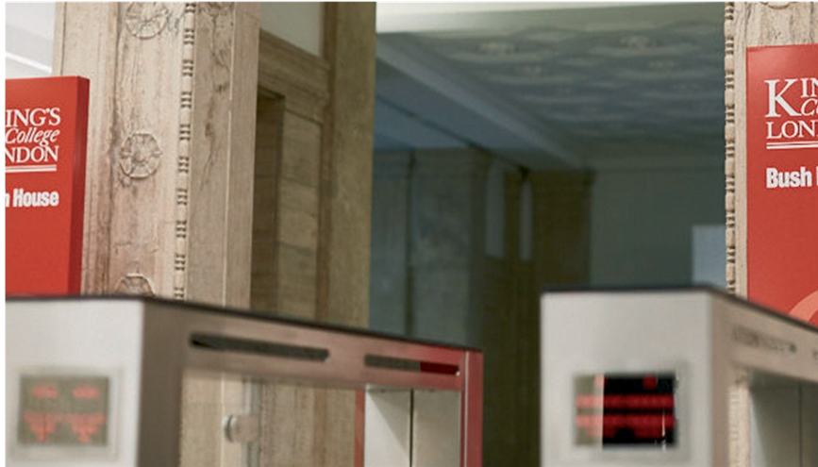
How to contact us
There are a number of different ways to contact us and these are outlined on your
General Informatics pages on KEATS
Microsoft Teams chat is not to be used to contact any member of staff directly
Notes:
Initially, the Department of Informatics office will not be open due to Covid Safety measures. This decision has been taken by the Faculty of Natural & Mathematical Sciences after an assessment of resources, safety measures and how best to support the student experience. The department will be working with student reps to receive feedback and adjust reasonably to what students require in order to support their studies.
In order to contact the department professional services team, there will be a number of methods:
Email: This can be used for all queries. The department has a 5 day SLA during non-busy periods. Where we see multiple queries on the same topic, we may choose to send an email to all students in order to answer. Where the question is answerable via FAQs, we will ask students to check these. Please note, the PS team is here primarily to answer Programme related queries, where possible we will try to answer other queries but if we cannot then you will be directed to a relevant team.
FAQs: The department has a list of most commonly asked questions. We ask that all students check this to ensure that their query has not been answered here before contacting the department.
KEATs Forums:
KEATs Chats:
Booking Virtual Meetings: Where your query is complex and needs a specific face to face conversation, the PS team will direct you to either a booking form or will set up a meeting with you directly.
Student Services: Student Services have a query system that answers a lot of questions not related to programmes, for example X. This is often a quick and easy way to get answers and we do encourage students to use this service
Please note, the PS team will not respond to any queries that come in through Microsoft Teams chats. The only accepted contact method will be those outlined on this slide.

Slide 4

Computer Credentials
K-number
Email, KEATS, Student Records, login to College computers
IT queries:
8888@kcl.ac.uk

Slide 5
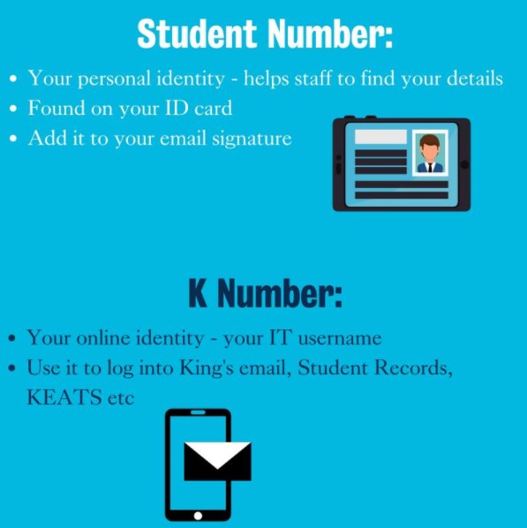
Difference between Student Number and K Number

Slide 6

Emails
Only use your kcl.ac.uk email address to email us
Check it daily!
Email Signature:
name
student number
programme of study
year of study (undergraduate students only)

Slide 7
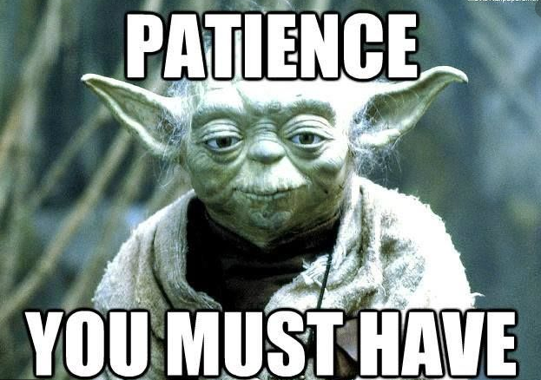
Response expectations
We aim to respond to your queries in a timely manner; more details of when you can expect a response are outlined on the General Informatics pages on KEATS

Slide 8
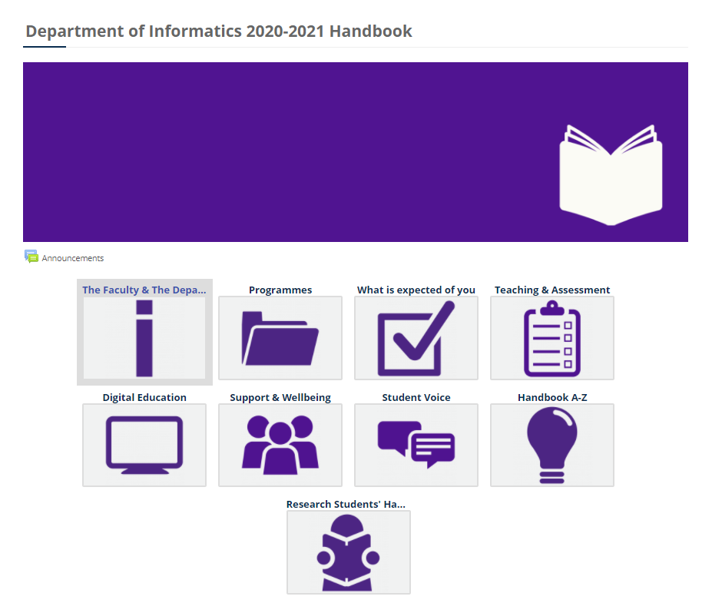
Key Resources
keats.kcl.ac.uk
Department Handbook:
Log into KEATS→ Search for ‘Informatics Handbook’→ Informatics Handbook 2020-2021
Notes:
Emphaise the information students can find in the handbook
currently mentions that lecture slides can be found in the handbook but these are found on the individual KEATS module pages, not in the handbook
currently refers to Programmes Officers as ‘Department Administrator’. This may cause confusion as this is Hari’s title. Change to ‘Programmes Officers’

Slide 9
Teaching
Asynchronous (not live and not on your timetable)
Lectures
The format of this will vary from module to module but could include:
Recorded material, split into 5-to-15-minute chunks
Reading of articles, book chapters etc.
Self-assessment activities
Synchronous (live and on your timetable)
Large group tutorials
These will be online, live and interactive
Small group tutorials
Small-group tutorials will vary from module to module; some modules may only have small-group tutorials every other week whilst others may have them every week
Some modules may have the option of small-group tutorials on campus (where this is the case, there will also be an online option for those not in London), whilst small-group tutorials for other modules will be solely online. This is driven by the type of module and the teaching content.
Notes:
More information can be found in the teaching infographic, found on your Informatics General Informatics pages
page

Slide 10
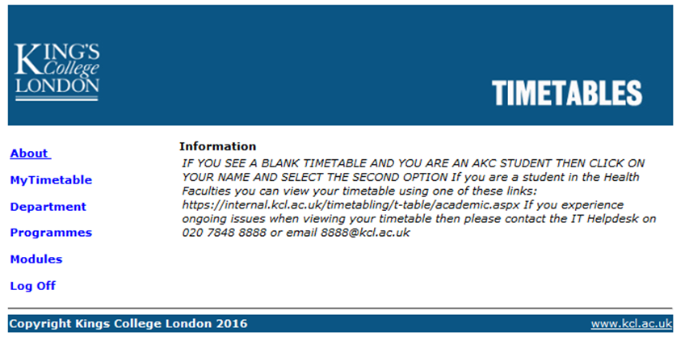
Your timetable
timetables.kcl.ac.uk
Mobile app: available to download
www.kcl.ac.uk/mobile/kingsmobile/install.aspx
or Google: ‘KCL Mobile App’

Slide 11
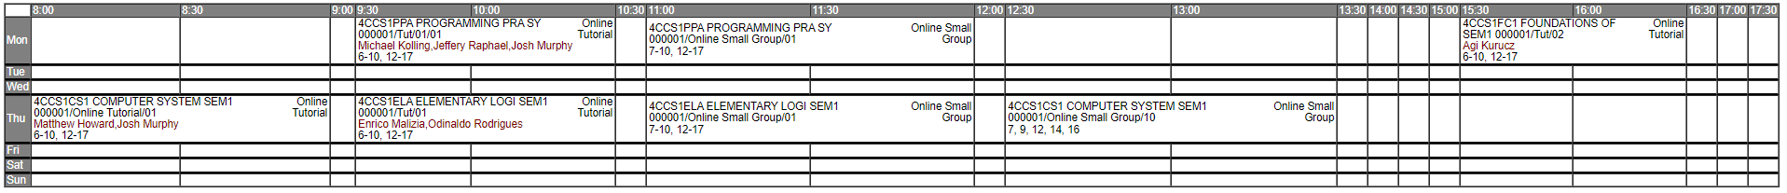

Your timetable – online only
Module code
Module title
Lecturer(s)
Session type
Teaching weeks
Each timetabled activity will have a link to the relevant KEATS module page where you will then be able to find the link to join the online session

Slide 12
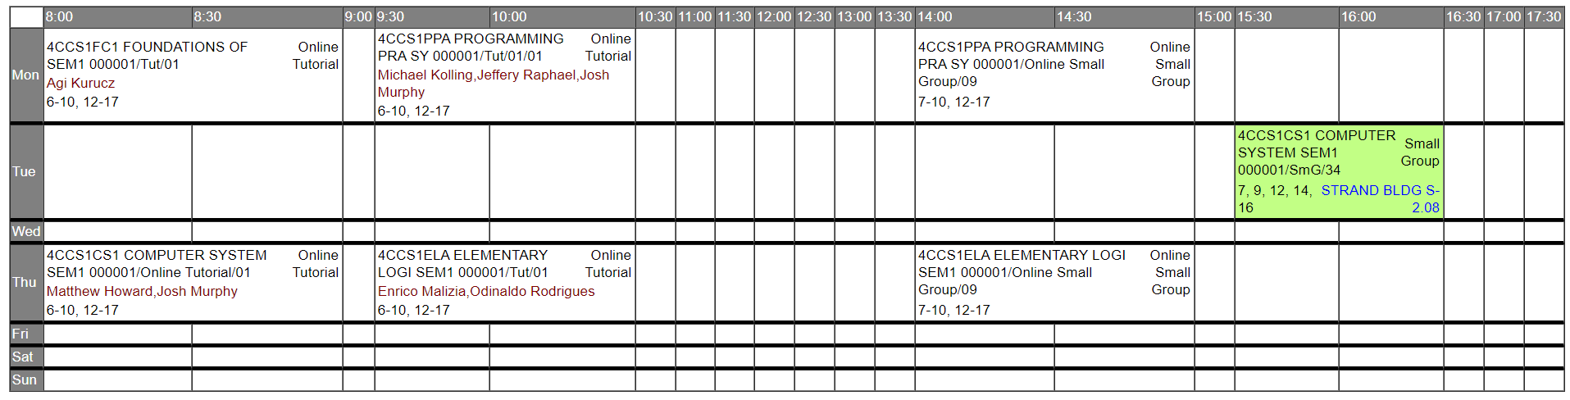

Your timetable – online and on campus
Module title
Module code
Session type
Teaching weeks
Location

Slide 13


How to find your room on campus
Which Campus? – letters
Which Building? – letters
Which room? – letters/numbers
e.g. WAT/F-WBB.5 = Waterloo Campus Franklin-Wilkins Building, Room B5
S5.01 = Strand Building, Floor 5, Room 01
Bush House (S)6.03= Bush House, South, Floor 6, Room 6.03

Slide 14
Getting Involved
Staff-Student Liaison Committee (SSLC):
It is one of the main avenues through which students can provide feedback to the Department.
Student Reps attend the department Student-Staff Liaison Committee (SSLC) representing the programme and year group for which they have been elected
Your student representative will deliver any feedback or concerns that you have to the committee in order to find solutions to problems that may arise
Student Reps have the opportunity to influence such things as the content and organisation of modules, library provisions and arrangements for induction
The meetings takes place twice each term. The Student-Staff Liaison Committee (SSLC) provides a platform for the views of the department’s students to be discussed with members of academic and administrative staff.
Your student rep will also report back to fellow students on the discussions that take place at the meetings and of any actions taken by the Department.
Rep elections – nominate yourself: www.kclsu.org/elections

Slide 15

Benefits of becoming a Student representative
An opportunity to relay the student voice to the department
Making a genuine contribution to the college
Help develop the learning partnership between staff and students
Public speaking and confidence
Develop transferable skills that will improve your employability prospects on your CV
Check the General Informatics pages for information on how to apply to become a representative

Slide 16




Other Ways to get Involved
Education Committee
Student Ambassador
Digital Ambassador
Student Societies

Slide 17
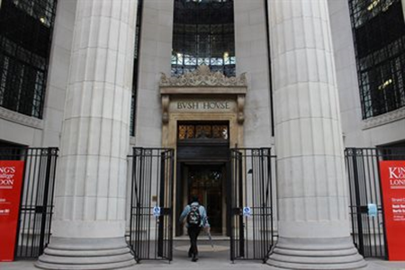
Campus
Under current Covid-19 safety measures, the College is asking that all students only come to campus for teaching or if they have a booked learning space. All safety measures will need to be adhered to.
.
Notes:
Bush House opening hours for students.
Students are not permitted to be in the building beyond the hours outlined above. Any student found in breech of this may have disciplinary action taken against, or face exclusion.
Outside of core hours (i.e. beyond 18:00 on weekdays and anytime on weekends/bank holidays) there is less support available for first aid and evacuating. Therefore students are advised to ensure they familiarise themselves with emergency procedures (i.e. evacuations or first aid).
Any student working in the Computer Labs in Bush House beyond 18:00 (until close) will need to use the facilities located on Level 6 South, all other labs will be closed.

